Slide 1



An Intro to Open Science
AIR R4R - Fall 22 (Based on slides by a number of other presenters)

Slide 2
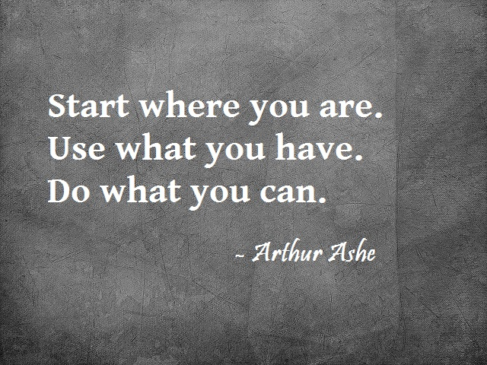

Slide 3
What is Open Science?
What is Reproducible Science?
What is Open (Reproducible) Science?

Slide 4
What is Open Science?
“Open Science is transparent and accessible knowledge that is
shared and developed through collaborative networks”
Vicente-Saes & Martinez-Fuentes 2018
Credit: Jessica Couture, UCSB, “Open Science & Metadata”

Slide 5
What is Open Science?
“Open science is the movement to make scientific research (including publications, data, physical samples, and software) and its dissemination accessible to all levels of society, amateur or professional.^{[1]} Open science is transparent and accessible knowledge that is shared and developed through collaborative networks.^{[2]} It encompasses practices such as publishing open research, campaigning for open access, encouraging scientists to practice open-notebook science, broader dissemination and engagement in science^{[3]} and generally making it easier to publish, access and communicate scientific knowledge.” - https://en.wikipedia.org/wiki/Open_science

Slide 6
What is Reproducible Science?
Reproducible science is when anyone (including others and your future self) can understand and replicate the steps of an analysis, applied to the same or even new data.
Credit: EarthLab, https://www.earthdatascience.org/courses/intro-to-earth-data-science/open-reproducible-science/get-started-open-reproducible-science/#:~:text=Reproducible%20science%20is%20when%20anyone,same%20or%20even%20new%20data.

Slide 7
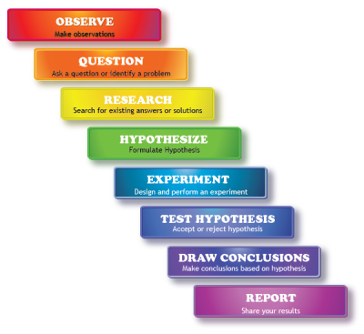
What is Open Science specifically?
Transparency, accessibility and reproducibility of science for:
...future you
...your collaborators
...the broader scientific/public community
Credit: Jessica Couture, UCSB, “Open Science & Metadata”

Slide 8
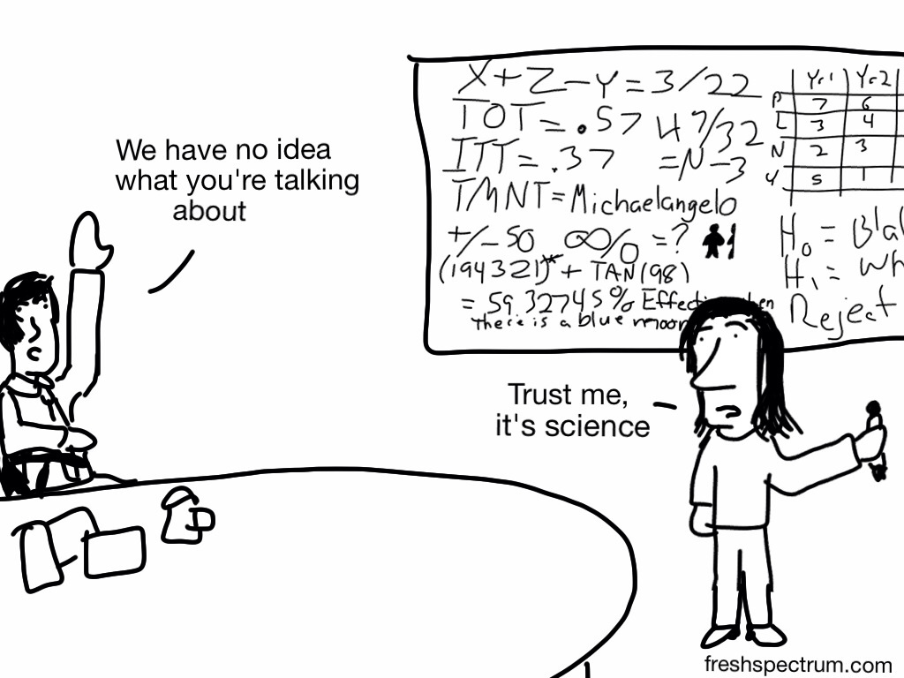
Why do Open Science?
Scientific community
Transparency
Efficiency
Equity & Diversity
Credit: Jessica Couture, UCSB, “Open Science & Metadata”

Slide 9
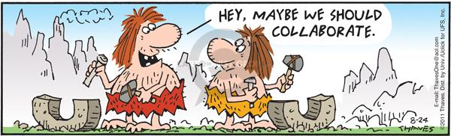
Why do Open Science?
Individual scientist
Efficiency
Broader community recognition
Foster collaborations
Increase value of your data/work
Credit: Jessica Couture, UCSB, “Open Science & Metadata”

Slide 10
What is Open Science specifically?
Planning
Doing the work
Sharing the results
Credit: Jessica Couture, UCSB, “Open Science & Metadata”

Slide 11
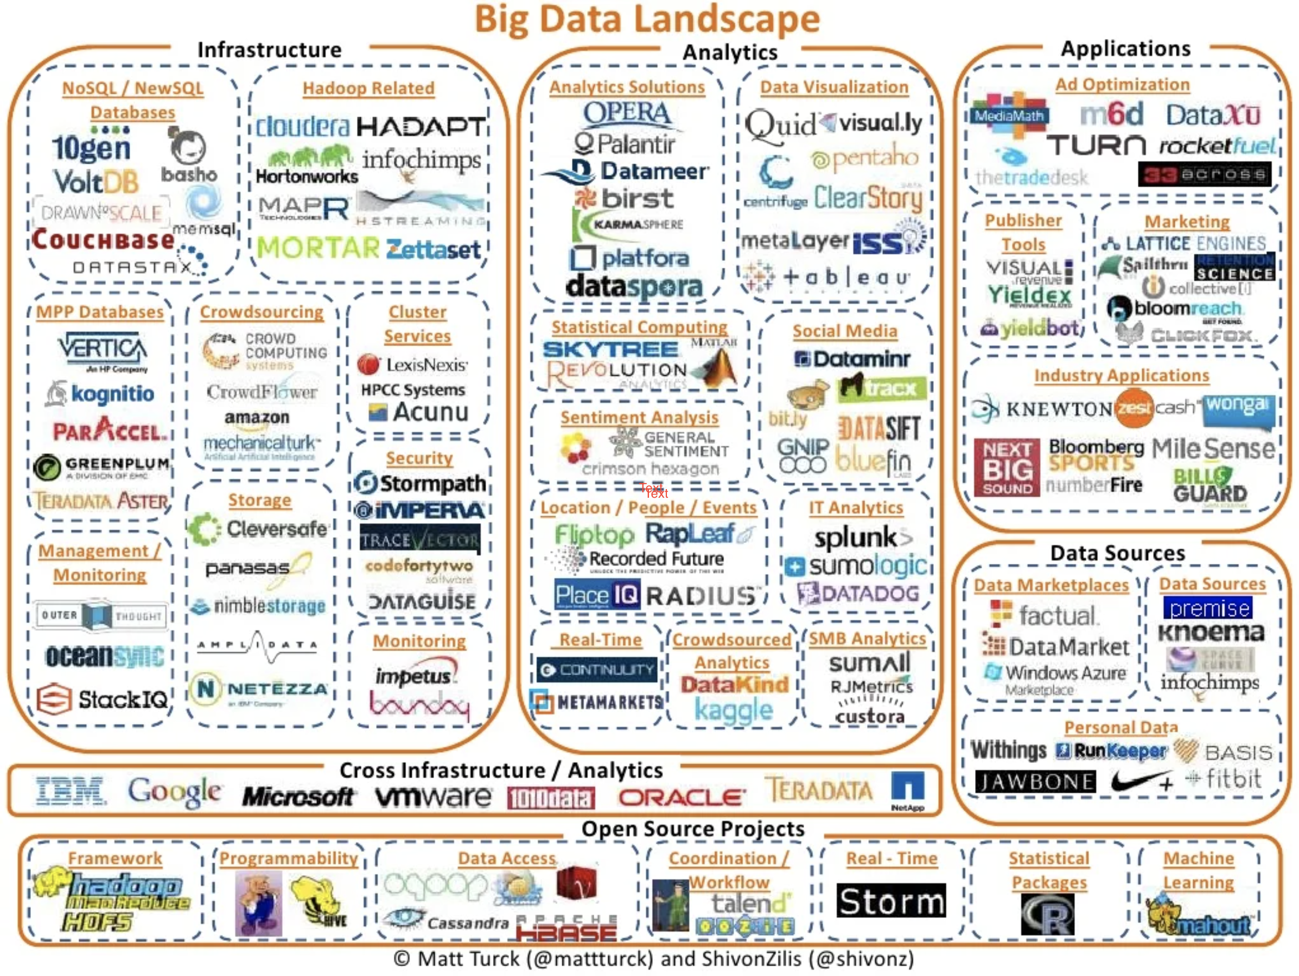
Matt Turck (v2012), https://mattturck.com/data2021/

Slide 12
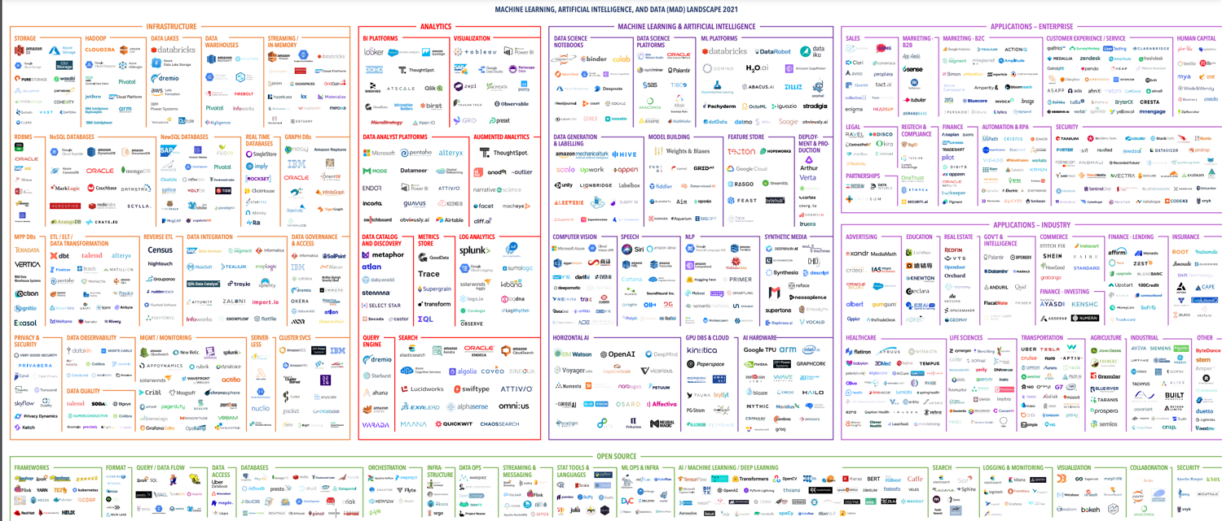
Matt Turck (v2021), https://mattturck.com/data2021/

Slide 13
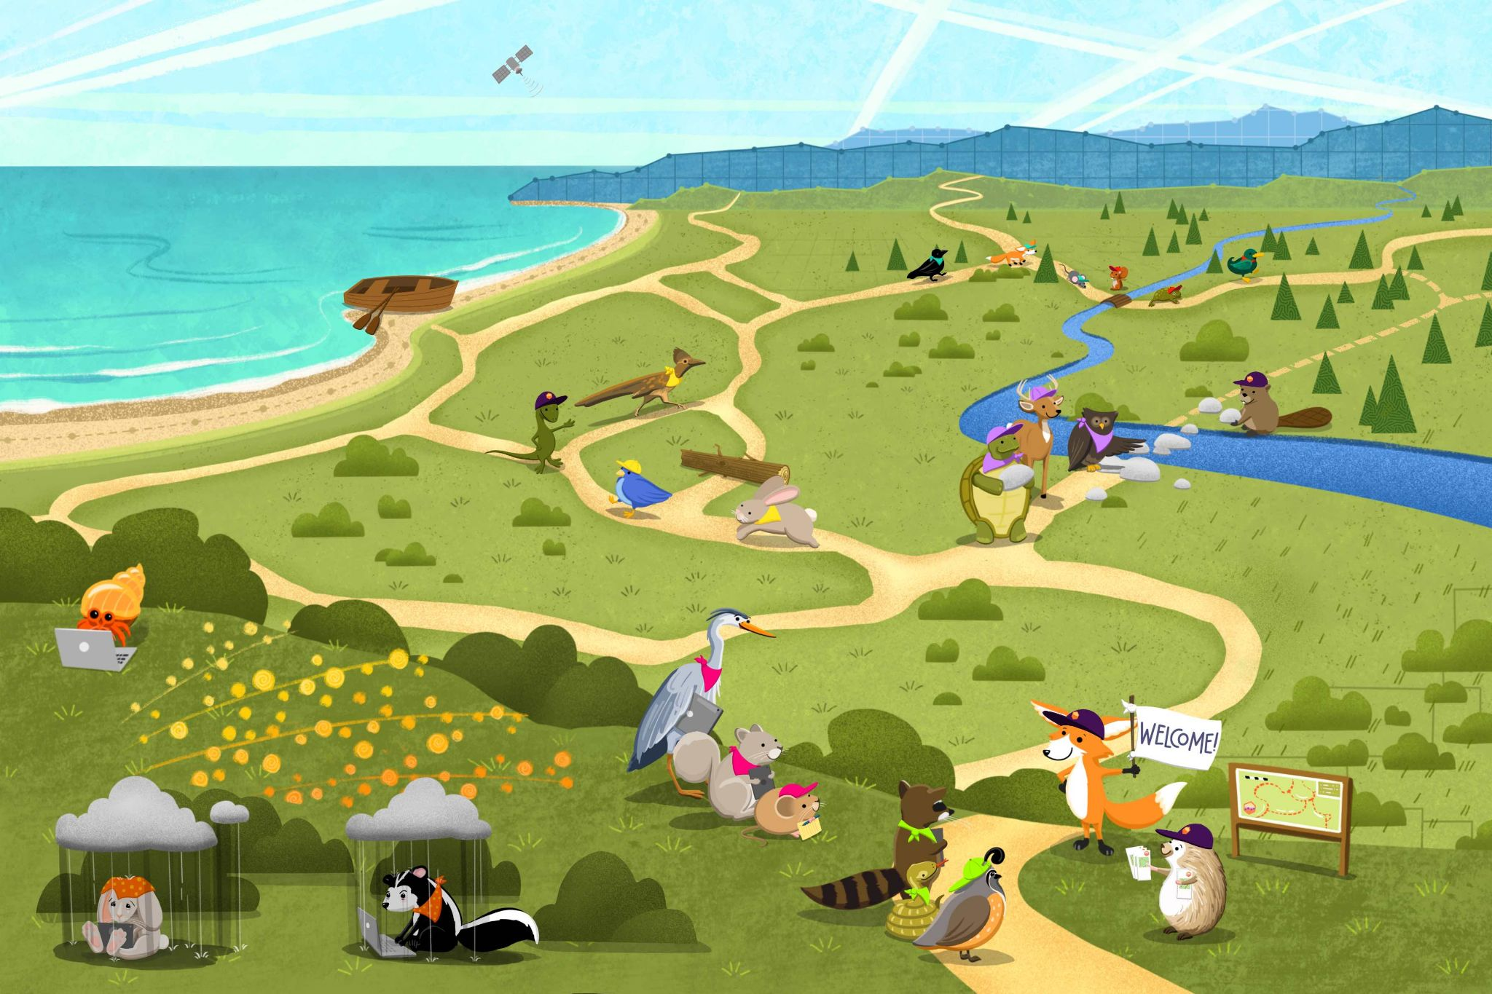
Many pathways for better science for future us
Credit: Openscapes Champions Program, https://openscapes.github.io/series/

Slide 14


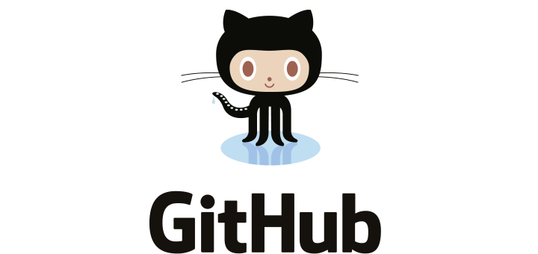
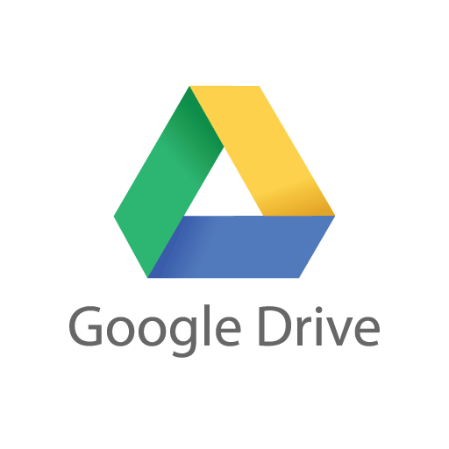






What is Open Science specifically?
Planning
Credit: Jessica Couture, UCSB, “Open Science & Metadata”

Slide 15
What is Open Science specifically?
Doing the work
Credit: Jessica Couture, UCSB, “Open Science & Metadata”

Slide 16

What is Open Science specifically?
Doing the work
Credit: Jessica Couture, UCSB, “Open Science & Metadata”

Slide 17

What is Open Science specifically?
Sharing results
Writing
Publish
Present
Report
Credit: Jessica Couture, UCSB, “Open Science & Metadata”

Slide 18


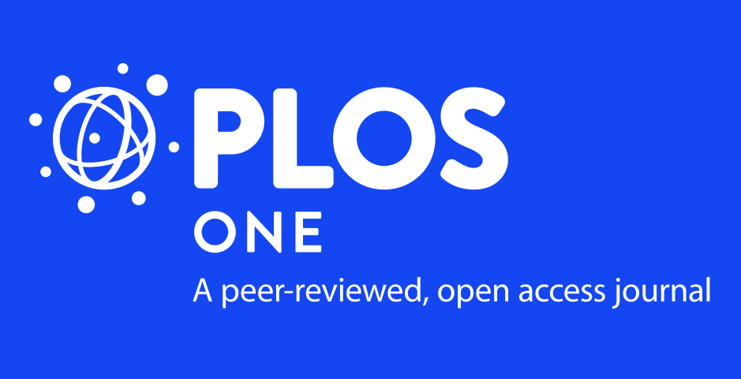
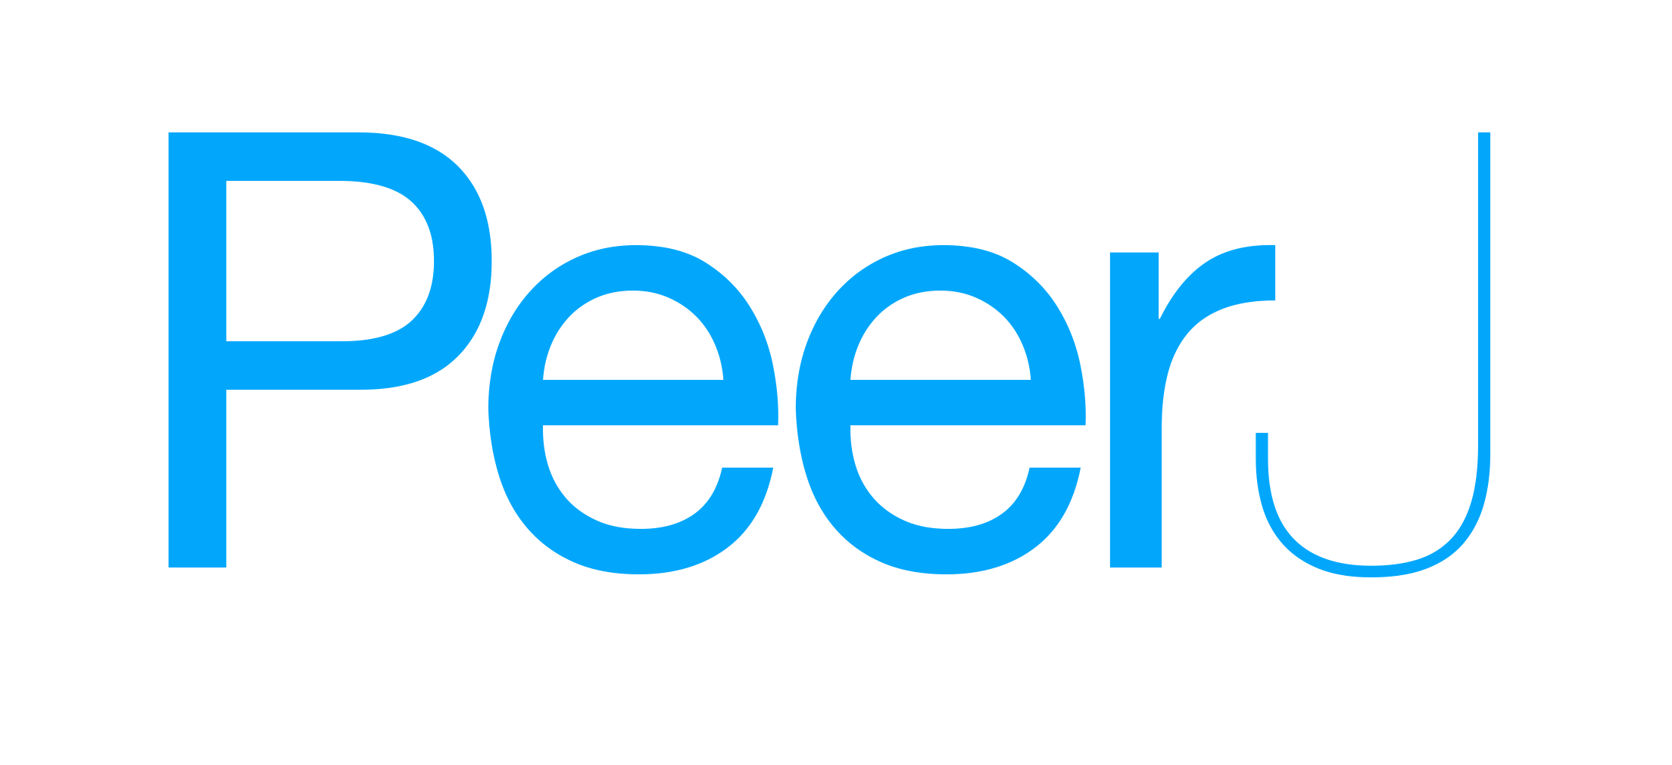
What is Open Science specifically?
Sharing results
Writing
Publishing
Publish
Present
Report
Credit: Jessica Couture, UCSB, “Open Science & Metadata”

Slide 19
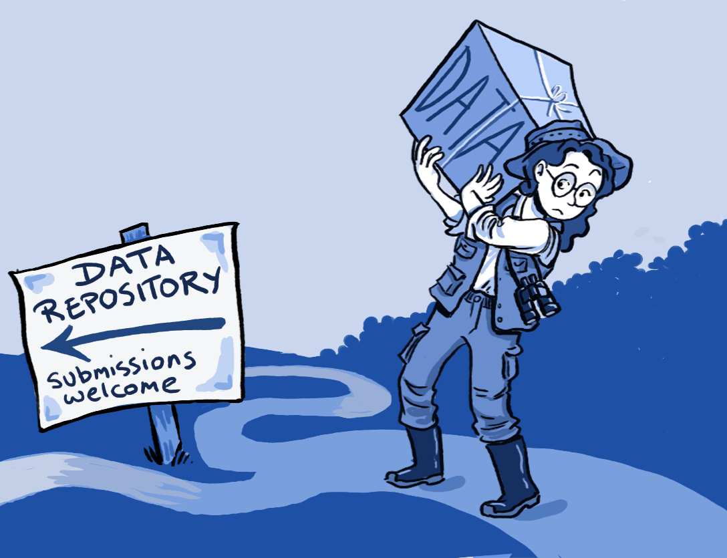
What is Open Science specifically?
Sharing results
Writing
Publishing
Publish
Present
Report
Data
Credit: Jessica Couture, UCSB, “Open Science & Metadata”

Slide 20


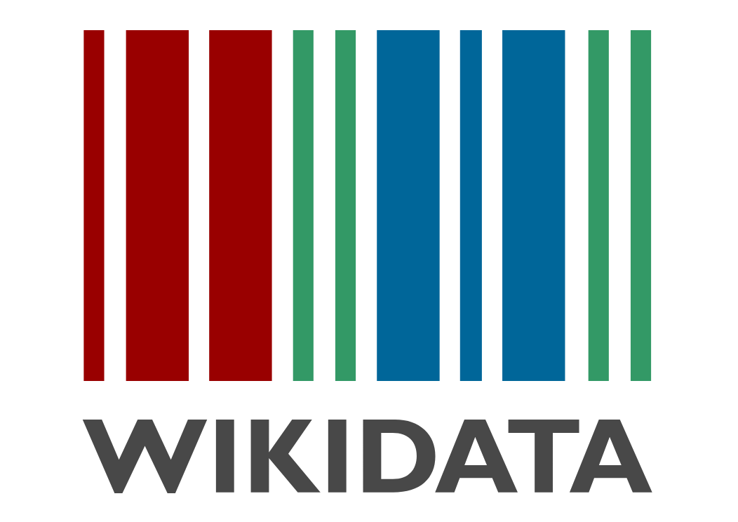
What is Open Science specifically?
Sharing results
Writing
Publishing
Publish
Present
Report
Data
Credit: Jessica Couture, UCSB, “Open Science & Metadata”

Slide 21
That’s a lot though...
Full open versioned workflows, open notebooks, public repos,
Reaching out to the broader community for help/feedback on ideas and methods,
Publish final data to repository
Personal reproducibility, publish in open access journals, local full metadata & clean data
Credit: Jessica Couture, UCSB, “Open Science & Metadata”

Slide 22


Is OS happening?
Should be!
Aside from personal motivations to work openly, public agencies and publicly funded work have requirements of public availability as a PUBLIC GOOD
Credit: Jessica Couture, UCSB, “Open Science & Metadata”

Slide 23
NIH Strategic Plan for Data Science
“NIH supports the generation and analysis of substantial quantities of biomedical research data [...] including numerous quantitative and qualitative datasets emanating from fundamental research using model organisms (such as mice, fruit flies, and zebrafish), clinical studies (including medical images), and observational and epidemiological studies (including data from electronic health records and wearable devices). [...]
By 2025, the total amount of genomics data alone is expected to equal or exceed totals from the three other major producers of large amounts of data: astronomy, YouTube, and Twitter. Indeed, next-generation sequencing data, stored at NIH’s National Center for Biotechnology Information (NCBI), has been growing exponentially for many years and shows no signs of slowing.”

Slide 24
NSF and NIH New Guidelines
NSF - 2018
All software and code must be in a versioned code repository (e.g., GitHub/BitBucket) and released immediately
Code should be well documented for others to reuse. We strongly encourage release of ready-to-use software and code through integration with computing resources (e.g., Galaxy, CyVerse)
In Virtual Machines (e.g., AWS, JetStream), and in Containers (e.g., Docker/DockerHub).
NIH - Effective January 2023
“[s]hared scientific data should be made accessible as soon as possible, and no later than the time of an associated publication, or the end of the award/support period, whichever comes first.”
Through the requirement to submit a Plan, researchers are prospectively planning for data sharing, which we anticipate will increasingly lead researchers to integrate data sharing into the routine conduct of research.
Notes:
https://grants.nih.gov/grants/guide/notice-files/NOT-OD-21-013.html
https://osp.od.nih.gov/scientific-sharing/nih-data-management-and-sharing-activities-related-to-public-access-and-open-science/

Slide 25
That’s a lot though...
Full open versioned workflows, open notebooks, public repos,
Reaching out to the broader community for help/feedback on ideas and methods,
Publish final data to repository
Personal reproducibility, publish in open access journals, local full metadata & clean data
Credit: Jessica Couture, UCSB, “Open Science & Metadata”

Slide 26
Where is your research/lab/discipline stack in this world of open and reproducible science?

Slide 27
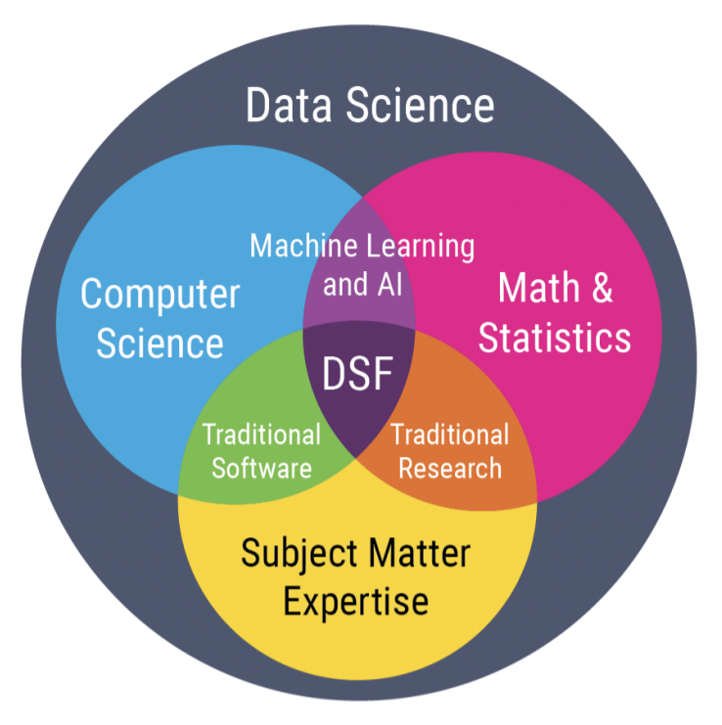
What we really need:
Research with
Data Science
requires
Team Science
Notes:
https://www.microsoft.com/en-us/research/wp-content/uploads/2009/10/Fourth_Paradigm.pdf

Slide 28
What is Open Science specifically?
Doing the work
Credit: Jessica Couture, UCSB, “Open Science & Metadata”

Slide 29
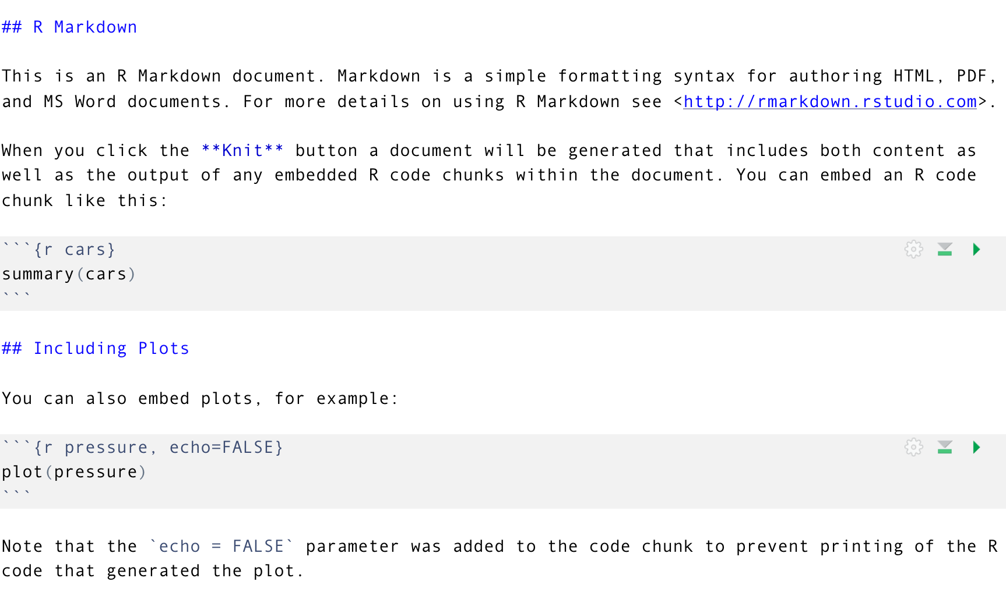
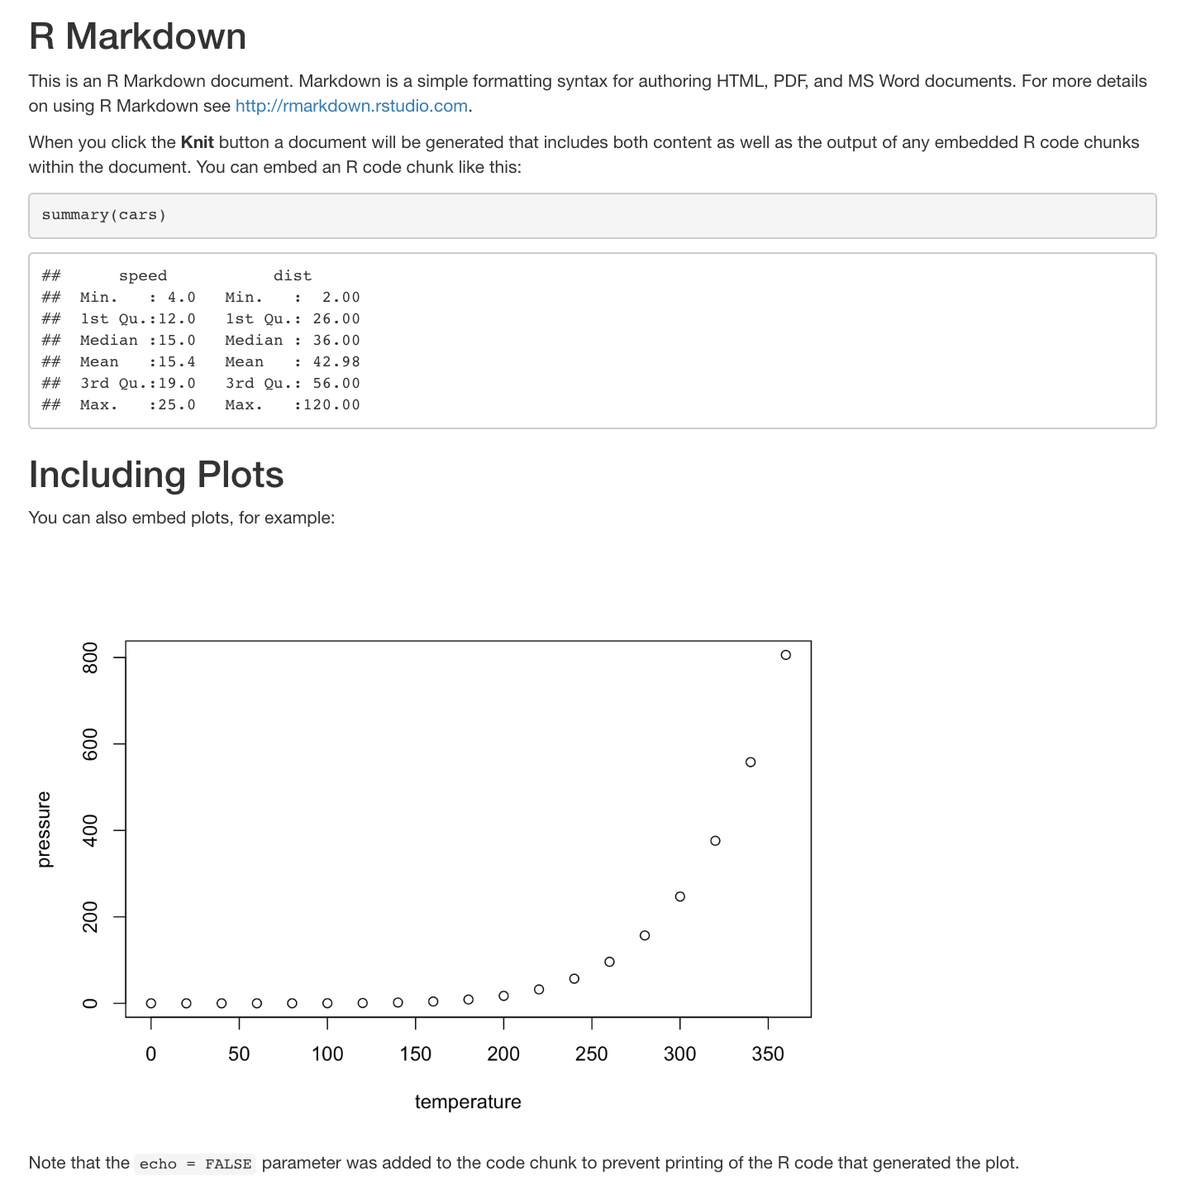
Reproducibility & communication enabled by open tools
RMarkdown: Analyses & figures together, rendered to your reporting output of choice.
Iteration & reproducibility
Communication: open, earlier
Text
Code – R, Python,
SQL, bash...
Our RMarkdown file renders to:
HTML!
Imagine never copy-pasting a graph into your doc again!!
Outputs as Word, PDF, HTML: Now you can share a URL rather than attaching a file!
And that same URL will update rather than re-attaching a new version of the file 😍
Credit: Openscapes Champions Program, https://openscapes.github.io/series/
Learn: rmarkdown.rstudio.com

Slide 30
Shared practices are useful beyond shared projects
Shared conventions reduce friction & cognitive load
Common ground, easier to talk about, easier to ask for help
You don’t need to design everything from scratch
But what about “your” way? Shared systems do constrain your behavior a little –
Credit: Openscapes Champions Program, https://openscapes.github.io/series/
Notes:
“I figured out how to do X, let me show you”

Slide 31
“It’s like agreeing that we will all drive on the left or the right. A hallmark of civilization is following conventions that constrain your behavior a little, in the name of public safety.”
Jenny Bryan & Jim Hester, What They Forgot to Teach You About R
Credit: Openscapes Champions Program, https://openscapes.github.io/series/

Slide 32
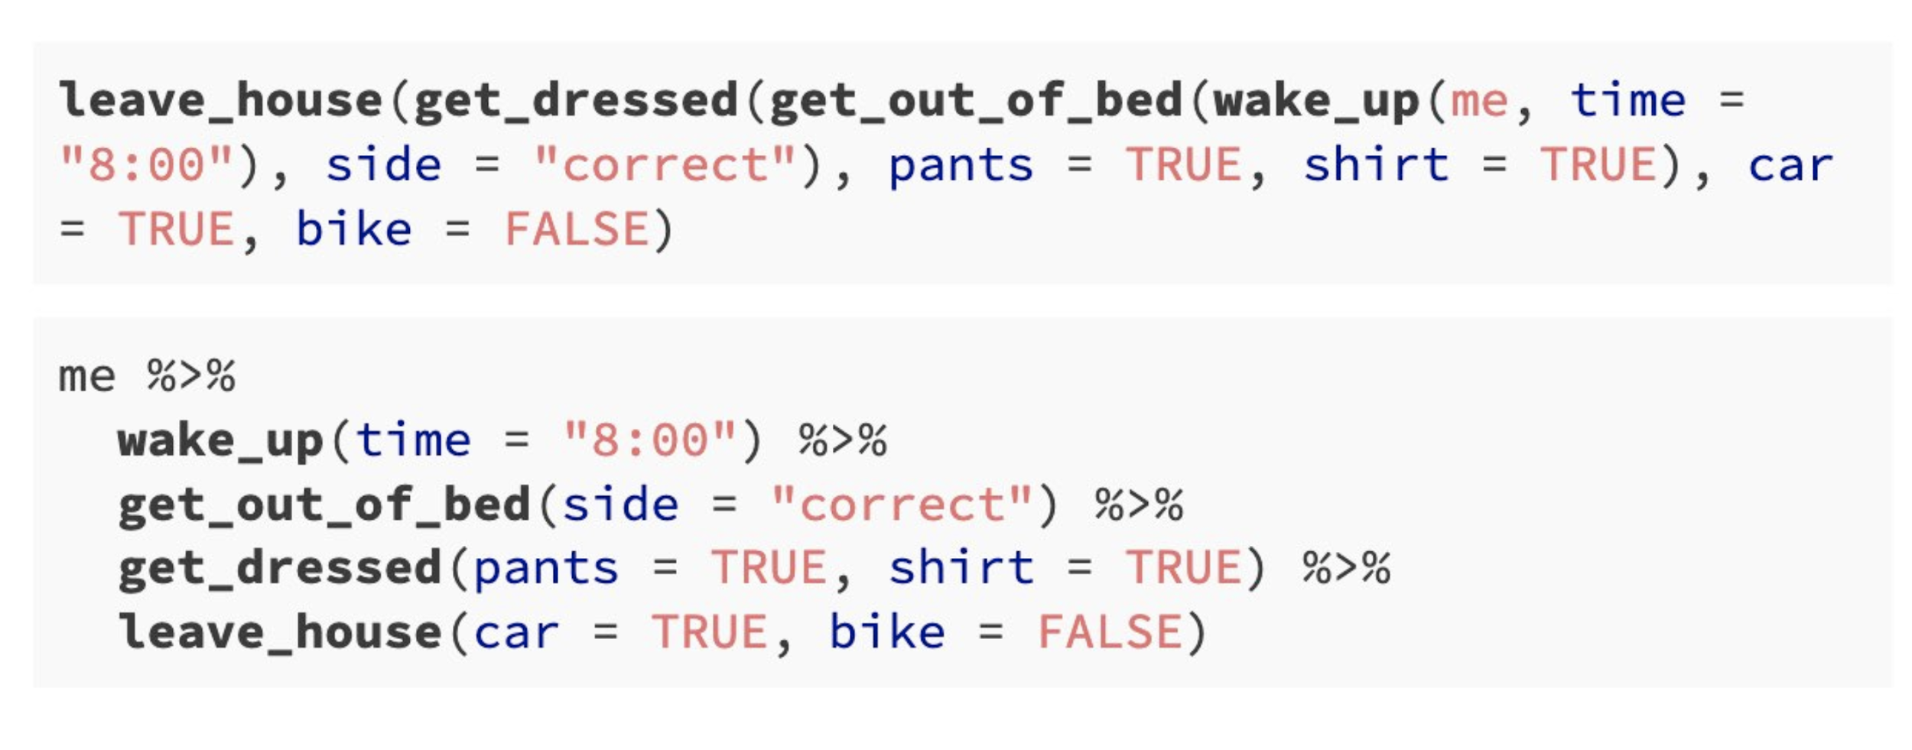
Shared practices are useful beyond shared projects
Same code written two ways
Nested
Piped %>%
Andrew Heiss, 2021
Credit: Openscapes Champions Program, https://openscapes.github.io/series/
Which is easier for you to come back to in a month? For your colleague to review?

Slide 33
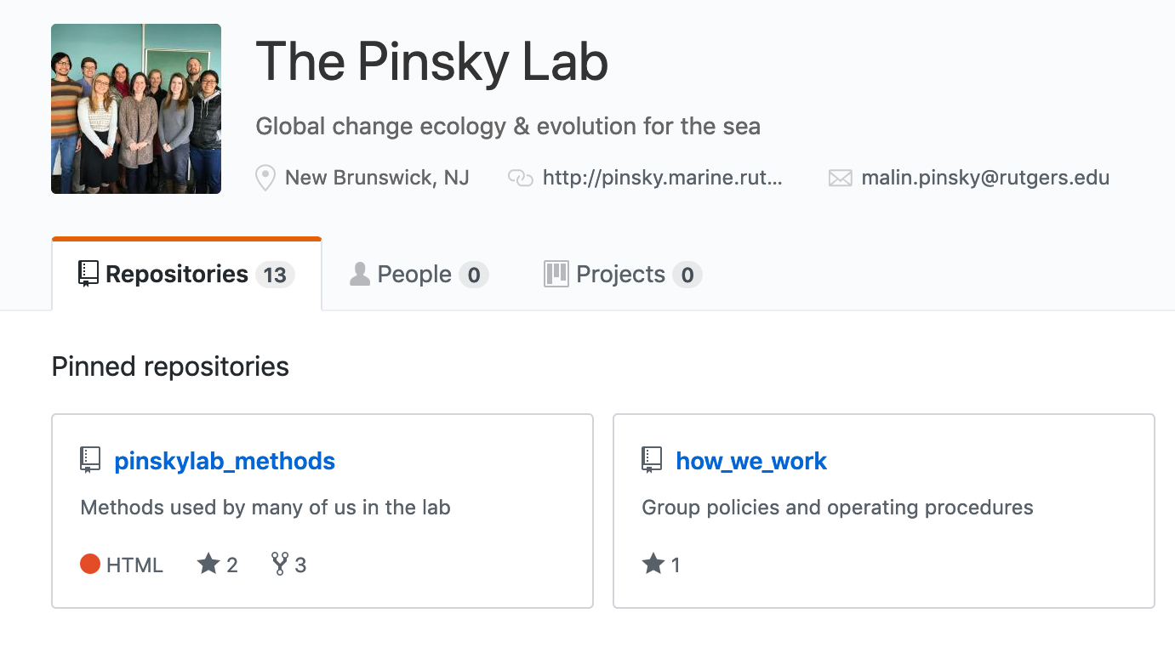
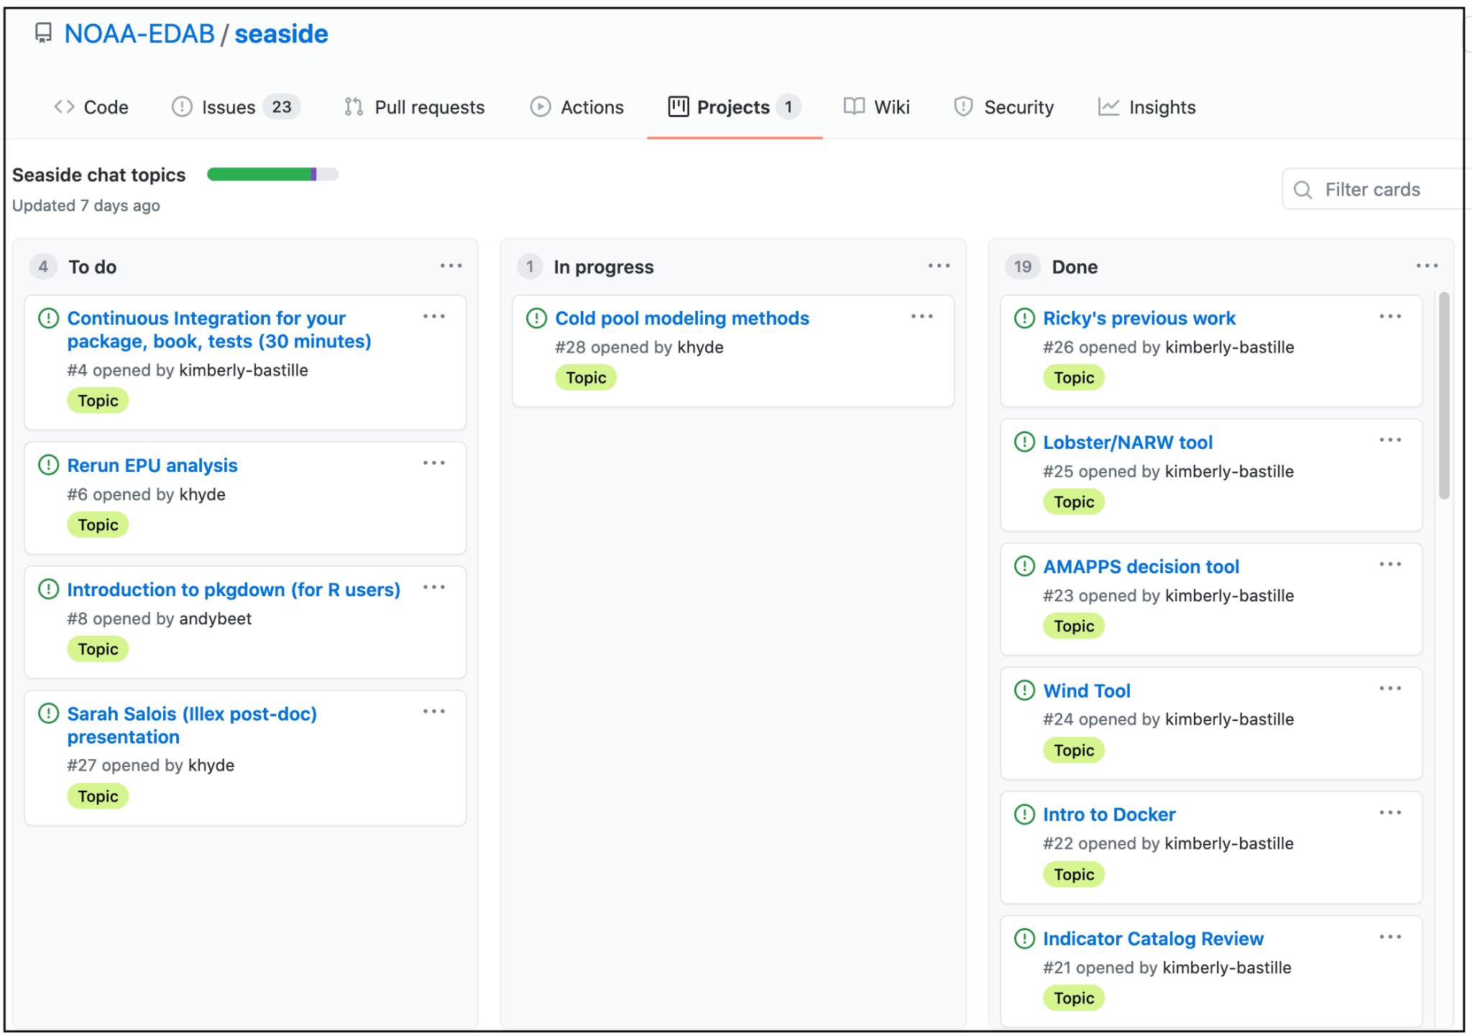
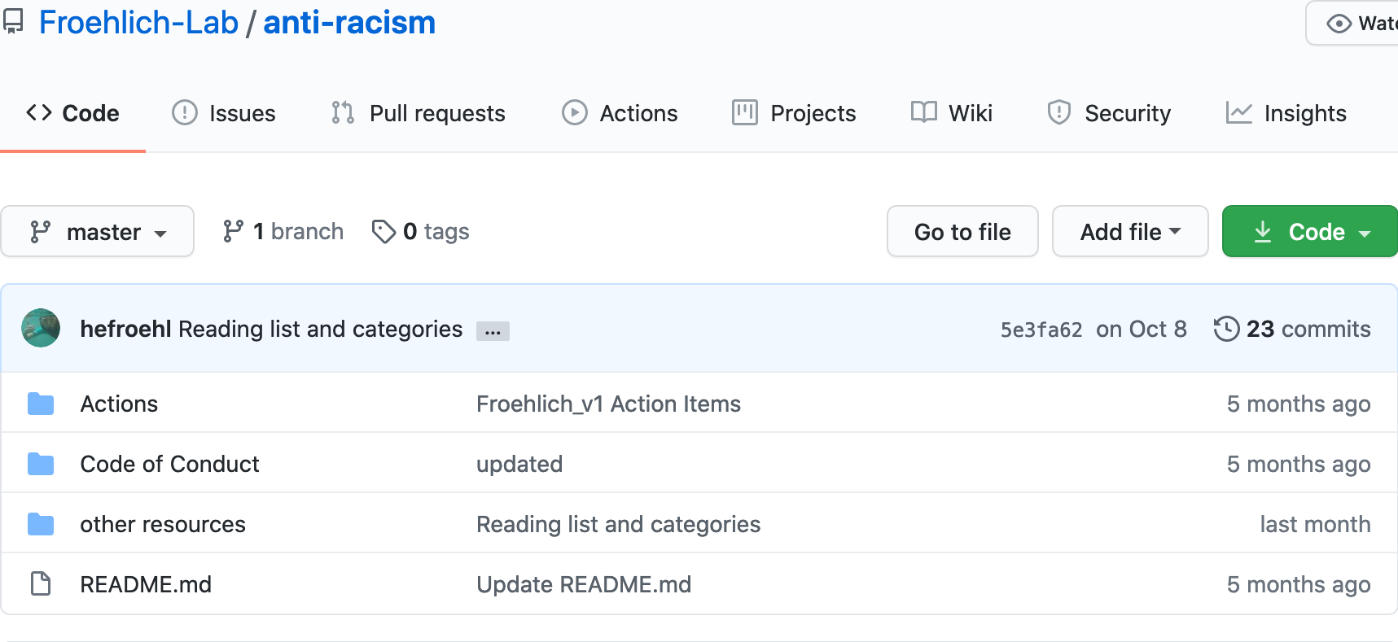
Reproducibility & communication enabled by open tools
GitHub: version control, archiving, collaboration, publishing, project management
Shared code, practices, resources, conversations
Credit: Openscapes Champions Program, https://openscapes.github.io/series/
Notes:
These are examples of using GitHub as a place for sharing code, sharing common practices around code, sharing resources for anti-racism, and also publishing codes of conduct and whole books using RMarkdown
These examples are with github but also important are tools like Google Drive, university servers, and things like Slack

Slide 34
Many pathways for better science for future us
Credit: Openscapes Champions Program, https://openscapes.github.io/series/

Slide 35
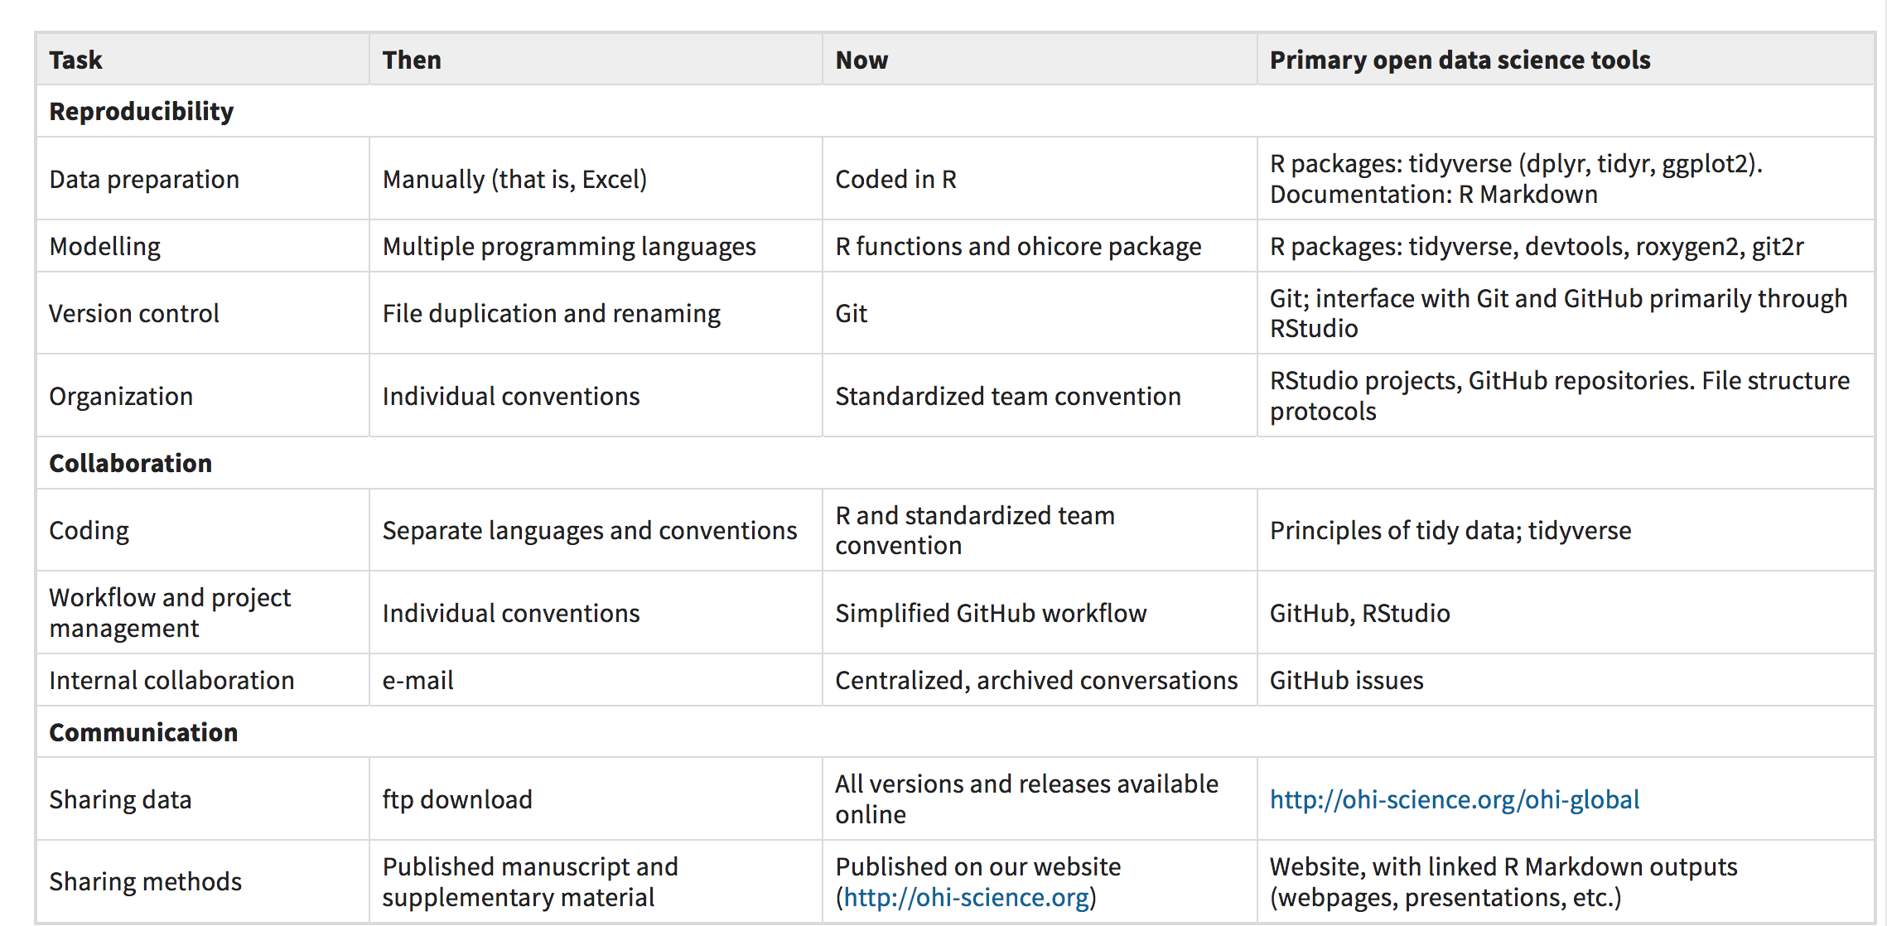
OHI’s pathway to better science in less time
Table 1, Lowndes et al. 2017
Credit: Openscapes Champions Program, https://openscapes.github.io/series/

Slide 36
Your Pathway
Trailhead
Path forward
Where are you right now? What tools do you use?
What will improve your path to discovery?
Reproducibility
Deliberately identify:
1) data workflow practices
2) next steps to facilitate efficiency and open, inclusive culture
Will help you create shared practices – important for resilience & onboarding.
metadata, data prep, analysis, version control, organization
Collaboration
coding,
storing data,
project mgmt,
internal discussions
Communication
sharing data,
sharing methods,
talks, teaching
Culture
Team agency,
mentorship, sponsorship
Credit: Openscapes Champions Program, https://openscapes.github.io/series/
Purpose: to deliberately identify data workflow practices in your group and next steps to facilitate efficiency and open culture. It will help create protocols for shared practices (important for onboarding). See also Lowndes et al. 2017 Table 1.

Slide 37
For Next Tuesday: What is Data Science? What skills do you need to do data science?

